Slide 1
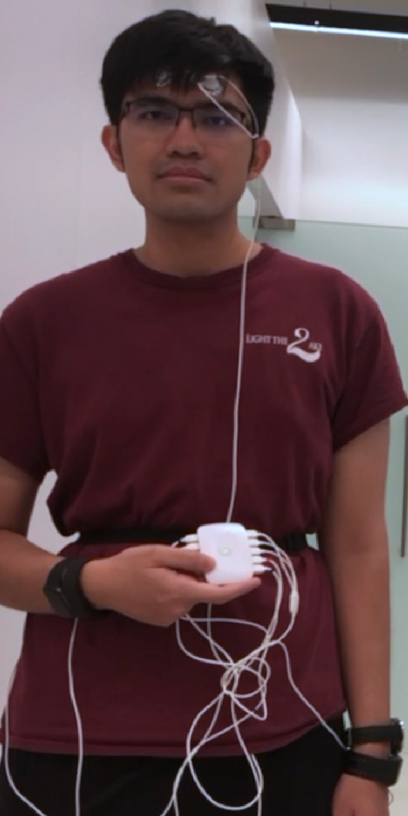
Full-Body Biofeedback Sensing - INTERFACES 2019
UWB(Radar)
EEG, EOG
EEG
Eye Tracker
ECG
EEG
IMU
RR
PPG
EDA(GSR)
3-Axes Accel.
Skin Temp
EMG
T. Wilaiprasitporn, INTERFACES, BRAIN VISTEC, Information Science and Technology, VISTEC

Slide 2

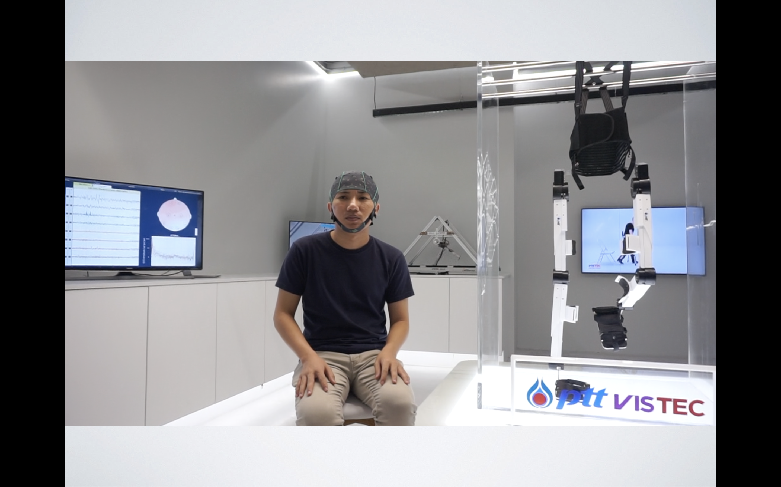

How to Study All of Those?
Researchers
Experimenters
Participants
Partners
Institutional Review Board (IRB)
People
Living Lab
T. Wilaiprasitporn, INTERFACES, BRAIN VISTEC, Information Science and Technology, VISTEC

Slide 3
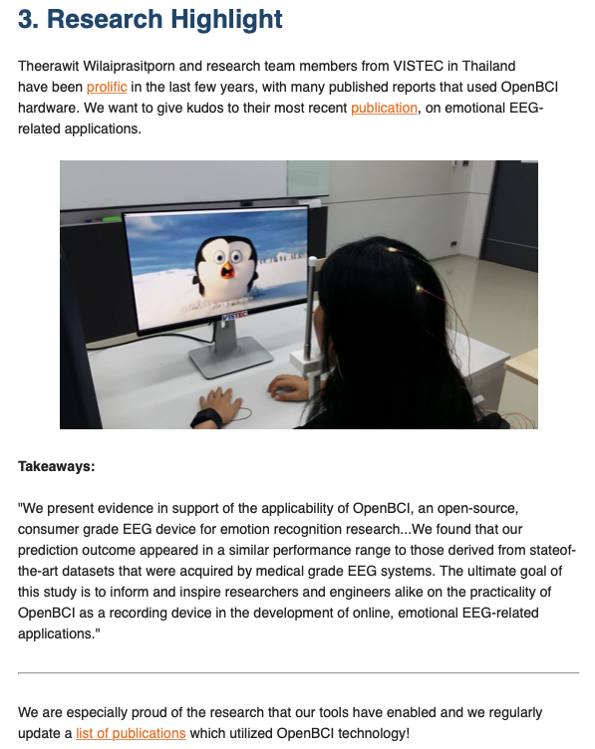
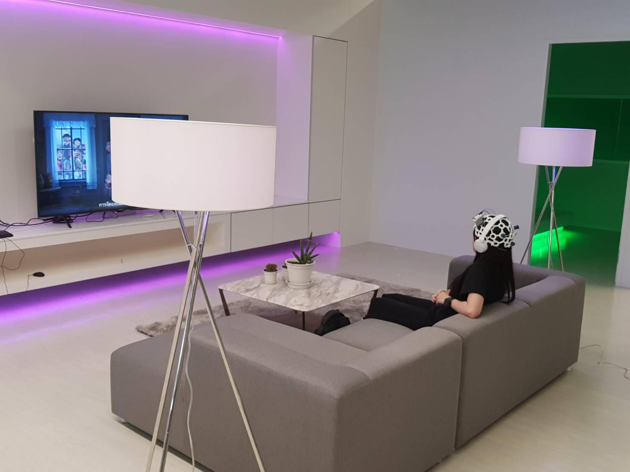
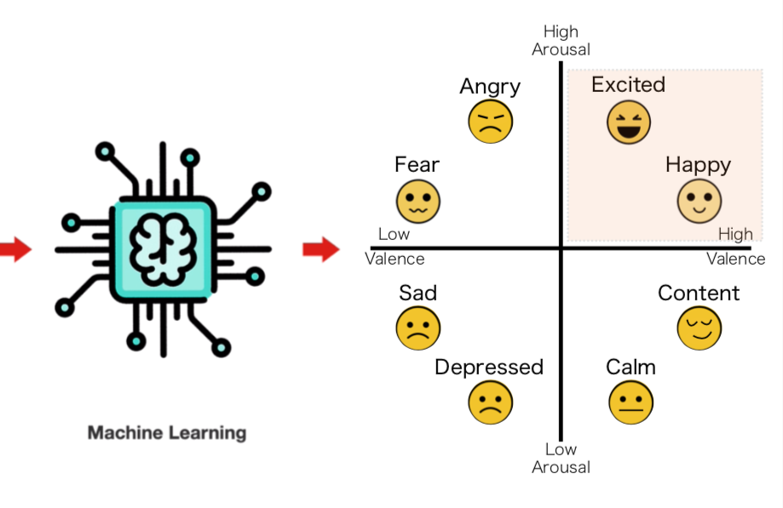
They did send out to all subscribers !!!
Affective Computing (for Media Tech.)
EEG
HR
EDA
Temp.
Machine Learning
P. Lakhan, N. Banluesombatkul, V. Changniam, R. Dhithijaiyratn, P. Leelaarporn, E. Boonchieng, S. Hompoonsup and T. Wilaiprasitporn*, “Consumer Grade Brain Sensing for Emotion Recognition,” in IEEE Sensors Journal, vol. 19, no. 21, pp. 9896-9907, 1 Nov.1, 2019

Slide 4
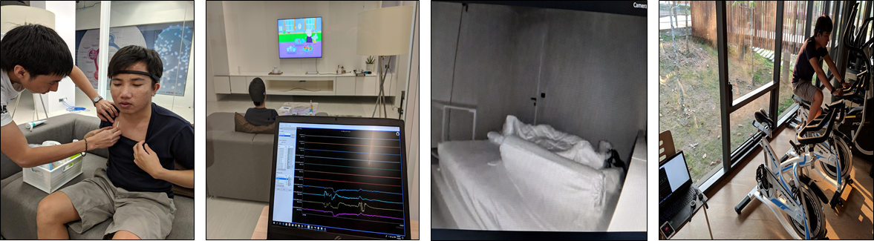
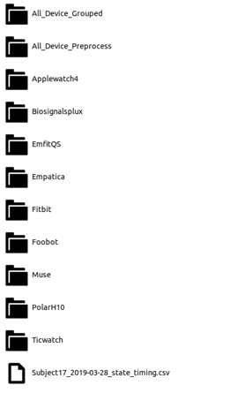
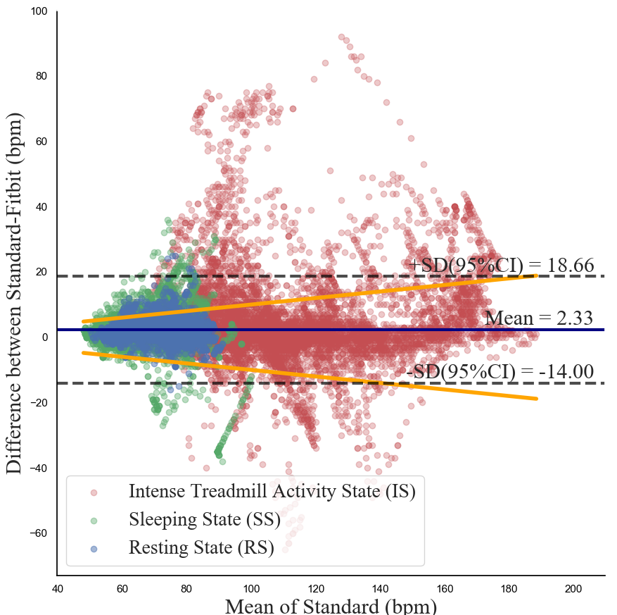
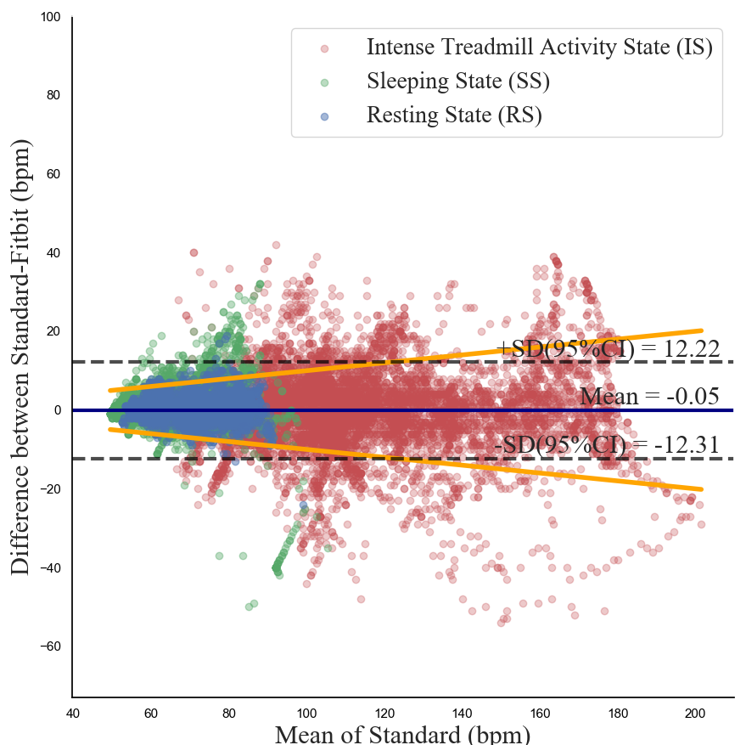
Wrist-Worn Device (Sleep & Exercise)
Skin Preparation
Resting
Sleeping
Intensity
Apple Watch 4
Empatica E4
Fitbit Charge HR
TicWatch Pro
Polar H10
Biosignalplux kit
Datasets from about 10 sensors
29 Participants
Machine Learning
Values !
Choksatchawathi, T., Ponglertnapakorn, P., Ditthapron, A., Leelaarporn, P., Wisutthisen, T., Piriyajitakonkij, M., & Wilaiprasitporn, T*. (2019). Improving Heart Rate Estimation on Consumer Grade Wrist-Worn Device Using Post-Calibration Approach. arXiv preprint arXiv:1910.07881.

Slide 5
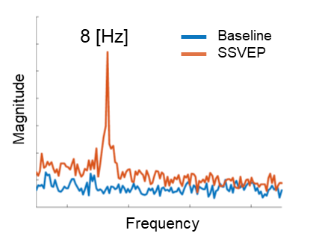
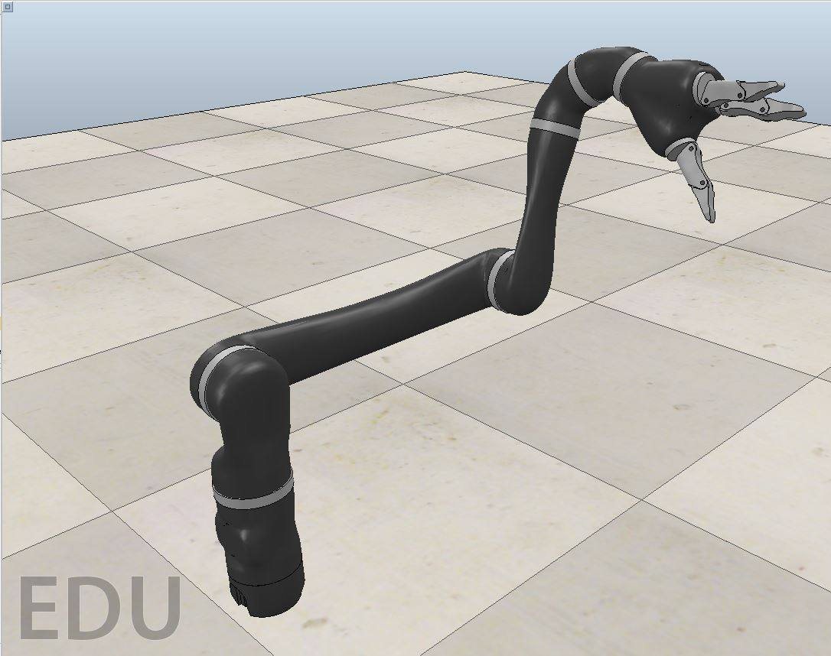
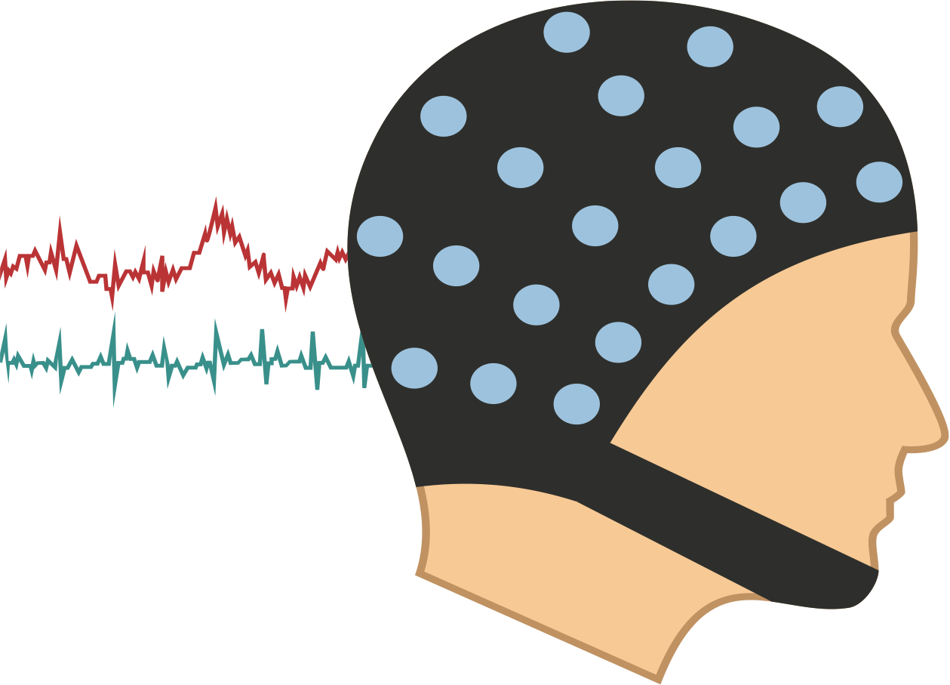
SSVEP-Based Brain-Computer Interfaces (Assistive Tech.)
SLOW
FAST
Updating intensities of stimuli
Pay Attention
Visual Feedback
Stimulation Interfaces
Frequency
classification
Direction Control
Brain signal acquisition
Pre-processing
Feature extraction
Speed Levels
Human
Response
Predictive model for SSVEP amplitude modulations
Jaco arm
P. Autthasan, X. Du, J. Arnin, S. Lamyai, M. Perera, S. Itthipuripat, T. Yagi, P. Manoonpong and T. Wilaiprasitporn, “A Single-Channel Consumer-Grade EEG Device for Brain-Computer Interface: Enhancing Detection of SSVEP and Its Amplitude Modulation,” in IEEE Sensors Journal.

Slide 6
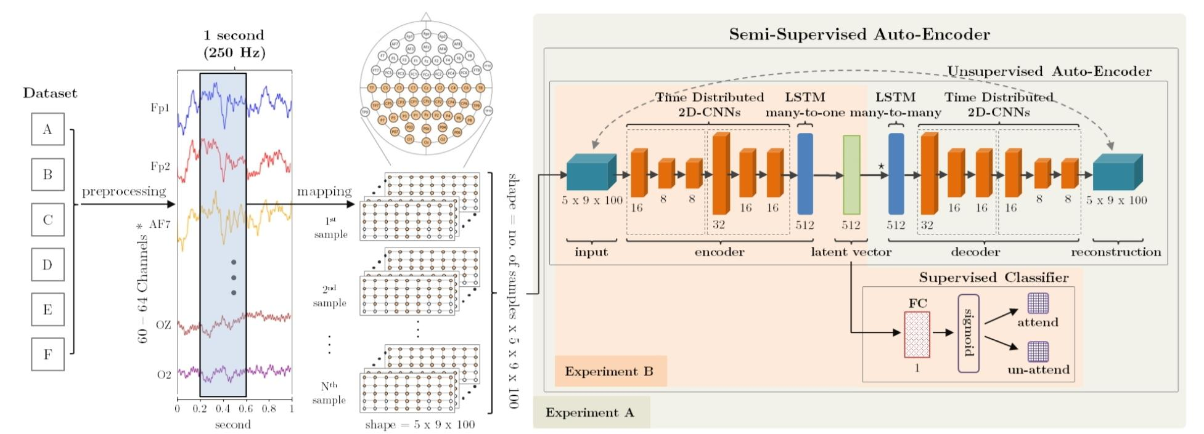
Human Brain - Artificial Brain
A. Ditthapron, N. Banluesombatkul, S. Ketrat, E. Chuangsuwanich and T. Wilaiprasitporn*, "Universal Joint Feature Extraction for P300 EEG Classification Using Multi-Task Autoencoder," in IEEE Access, vol. 7, pp. 68415-68428, 2019
T. Wilaiprasitporn*, A. Ditthapron, K. Matchaparn, T. Tongbuasirilai, N. Banluesombatkul and E. Chuangsuwanich, “Affective EEG-Based Person Identification Using the Deep Learning Approach,” in IEEE Transactions on Cognitive and Developmental Systems (early access)

Slide 7
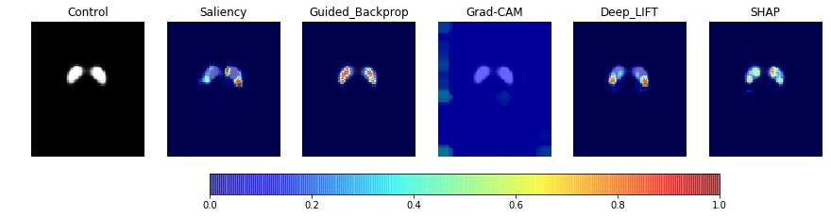
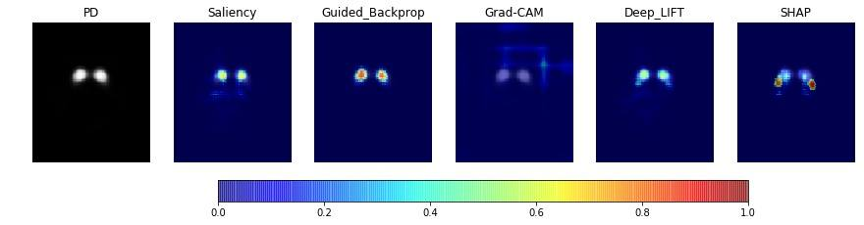
Human Brain - Artificial Brain
Pianpanit, Theerasarn, et al. (T. Wilaiprasitporn*). " Interpreting deep learning prediction of the Parkinson's disease diagnosis from SPECT imaging" arXiv preprint arXiv:1908.11199 (2019)

Slide 8
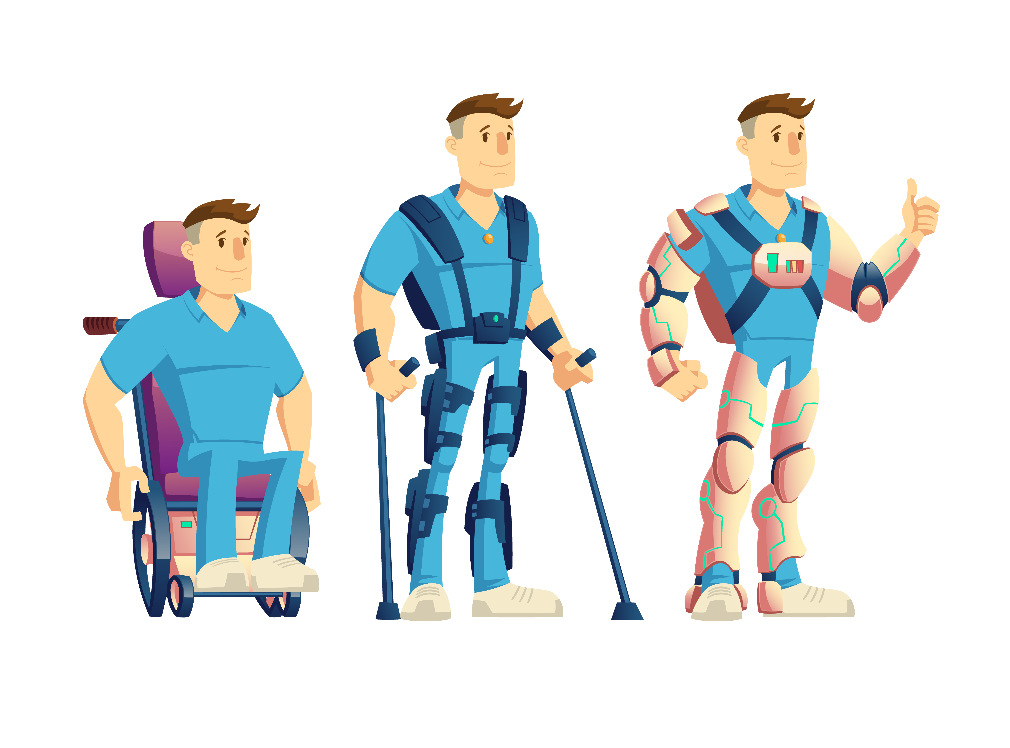
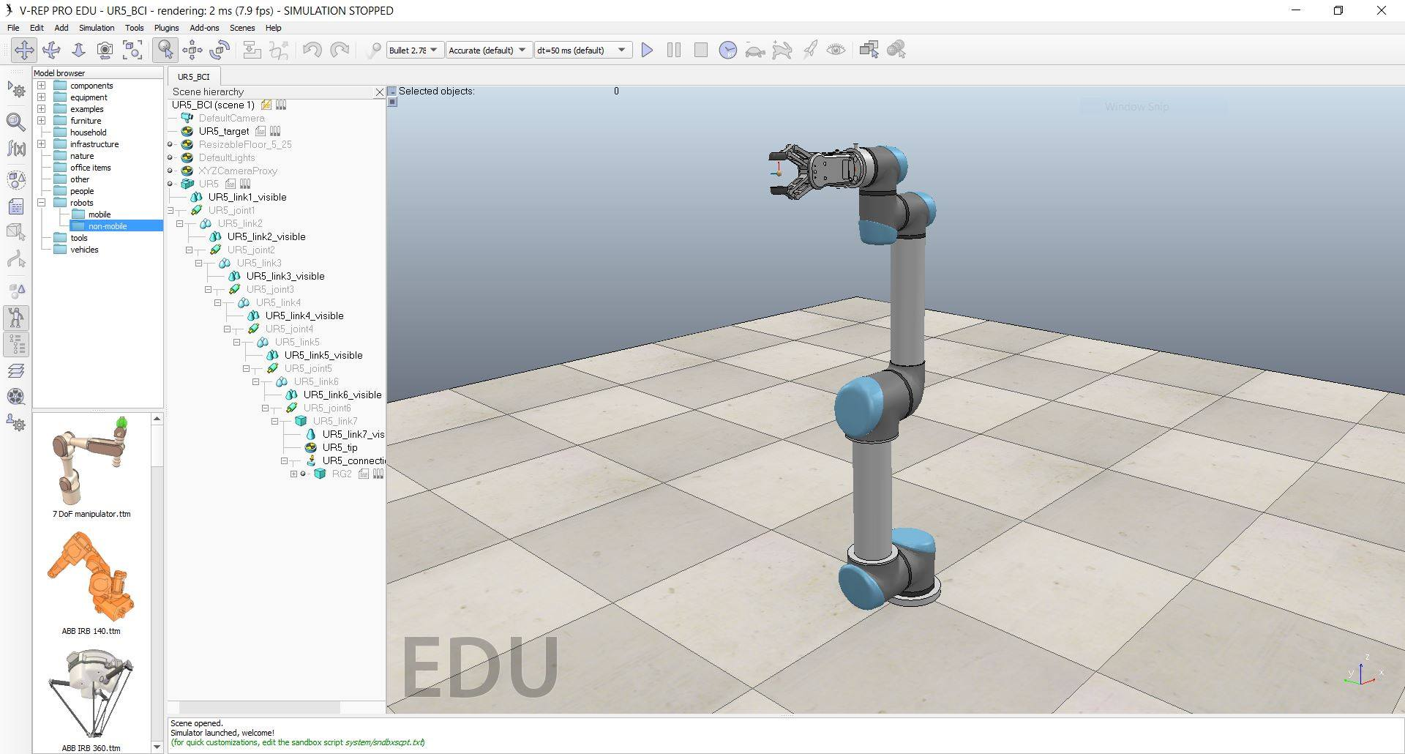
Online Brain-Computer Interfaces (BCIs)
Brain signal acquisition
Pre-processing
Feature extraction
Classification model
Exoskeleton
Robotics arm
“Motor imagery (MI) is defined as the cognitive process of imagining the movement of your own body part without actually moving that body part”
Feedbacks: Visual, Haptics, Auditory, etc.

Slide 9
What’s next-2020?
Prototype & Validation
BIAS
NN Lab
?
Man
Collaboration (research / support)
People
Living Lab
Outputs
Commercialized
Money
Machine
Patent
Publication
Consumer
Communication
(to Investors)
1 Petty Patent, Applied

Slide 10
EECi
Collaboration
IST VISTEC
BRAIN VISTEC
INTERFACES
Thailand

Slide 11
2019 Full Articles
T. Wilaiprasitporn*, A. Ditthapron, K. Matchaparn, T. Tongbuasirilai, N. Banluesombatkul and E. Chuangsuwanich, "Affective EEG-Based Person Identification Using the Deep Learning Approach," in IEEE Transactions on Cognitive and Developmental Systems.
P. Lakhan et al. (T. Wilaiprasitporn*), "Consumer Grade Brain Sensing for Emotion Recognition," in IEEE Sensors Journal, vol. 19, no. 21, pp. 9896-9907, 1 Nov.1, 2019.
A. Ditthapron, N. Banluesombatkul, S. Ketrat, E. Chuangsuwanich and (T. Wilaiprasitporn*), "Universal Joint Feature Extraction for P300 EEG Classification Using Multi-Task Autoencoder," in IEEE Access, vol. 7, pp. 68415-68428, 2019.
Autthasan, Phairot, et al. (T. Wilaiprasitporn*). " A Single-Channel Consumer-Grade EEG Device for Brain-Computer Interface: Enhancing Detection of SSVEP and Its Amplitude Modulation
." in IEEE Sensors Journal.
Choksatchawathi, Tanut, et al. (T. Wilaiprasitporn*). "Improving Heart Rate Estimation on Consumer Grade Wrist-Worn Device Using Post-Calibration Approach." arXiv preprint arXiv:1910.07881 (2019).
Pianpanit, Theerasarn, et al. (T. Wilaiprasitporn*). " Interpreting deep learning prediction of the Parkinson's disease diagnosis from SPECT imaging" arXiv preprint arXiv:1908.11199 (2019)
.
P. Sawangjai, S. Hompoonsup, P. Leelaarporn, S. Kongwudhikunakorn, and T. Wilaiprasitporn*. "Consumer Grade EEG as Research Tools: A Review" preprint on ResearchGrade
*corresponding author

Slide 12
Thank you to INTERFACES-2019 :3
Core Team (10 PhD students, 5 research assistant) and National Collaborators
Electrical Engineer (Bio signal Processing and Control)
Computer Scientists/Engineers (Machine Learning, Deep Learning)
Biomedical Engineer (Parallel Computing for Bio signal Processing)
Neurologists (Dementia, Sleep Medicine)
Neuroscientists (Visual Attention)
Psychologist (Bias & Decision Making)
Robotic Engineer (Bio-Inspired Robotic, BRAIN VISTEC)
International Collaborators
Fatigue Countermeasure Lab @ NASA Ames Research Center
Yagi Lab (Neural Engineering) @ TokyoTech
Brain Dynamic (Thai Startup for EEG)

